Slide 1

Local Business Employee Management
Team Name: Nidhyana
Shweta Terkar
Divyangi Rathore
Damanpreet Singh
Arun Konda

Slide 2
Topics Covered
Introduction
Timeline
Change Management
What changed since Midterm
Demonstration of Web Portal

Slide 3
1. Introduction to our Project
Creating a website called ‘Local Business Employee Management’
Assist local business units to find employees for their needed positions and citizens to find jobs as per their requirements
Job seekers create their profiles and upload their resumes
Companies will be able to post their job opening very easily
LBEM will match the employer and the employee together
Main goal for our project is to reduce the unemployment rate in the G.R. region

Slide 4
2. Timeline

Slide 5
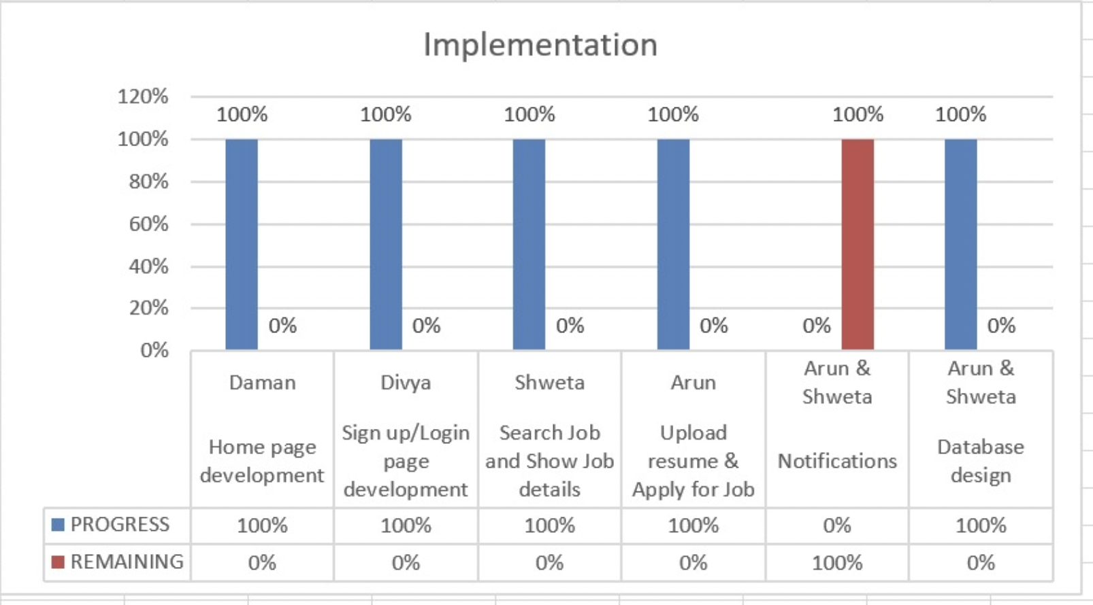

Implementation Timeline

Slide 6
Change management plan
Train people to use portal
Integrating with ecosystem/software
Discovering issues

Slide 7
Training users
Creating
Creating video tutorial:
Functionalities of the website pages and uses
Registering and sign in
Searching for a job and applying
Preparing
Preparing survey and gathering pilot data
Fix issues based on feedback

Slide 8
Integration with ecosystem/software
Developed with both MacOS and WindowsOS
Install XAMPP on the system.
Initiate Apache server & MySQL database as below:
Download the LBEM.zip folder and extract it. Keep the extracted folder in below path: C:\xampp\htdocs.
Open the localhost link
We will continue to test the application for all the ecosystems to make sure it has been properly integrated.

Slide 9
Discovering issues
Put web portal through more rigorous testing by developers and many users
Sending issues to log or register
Giving priority to critical issues
Solve critical issues < 2 – 3 hours
Solve other issues within 1 – 2 days

Slide 10
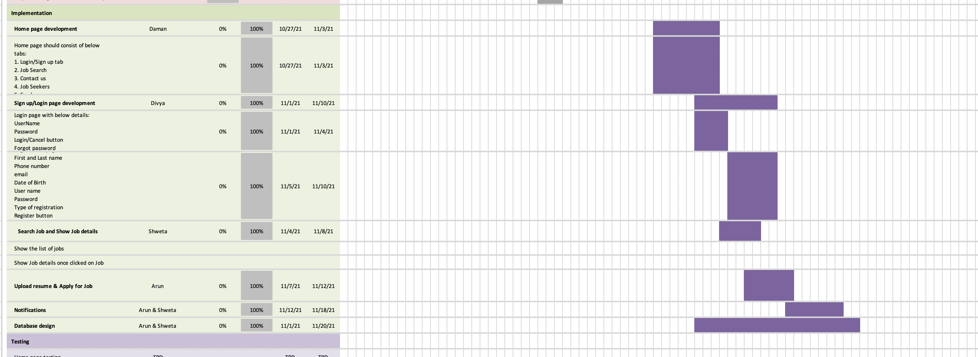
What Changed Since Midterm

Slide 11

Demonstration of Portal
Thank You ☺

